Slide 1
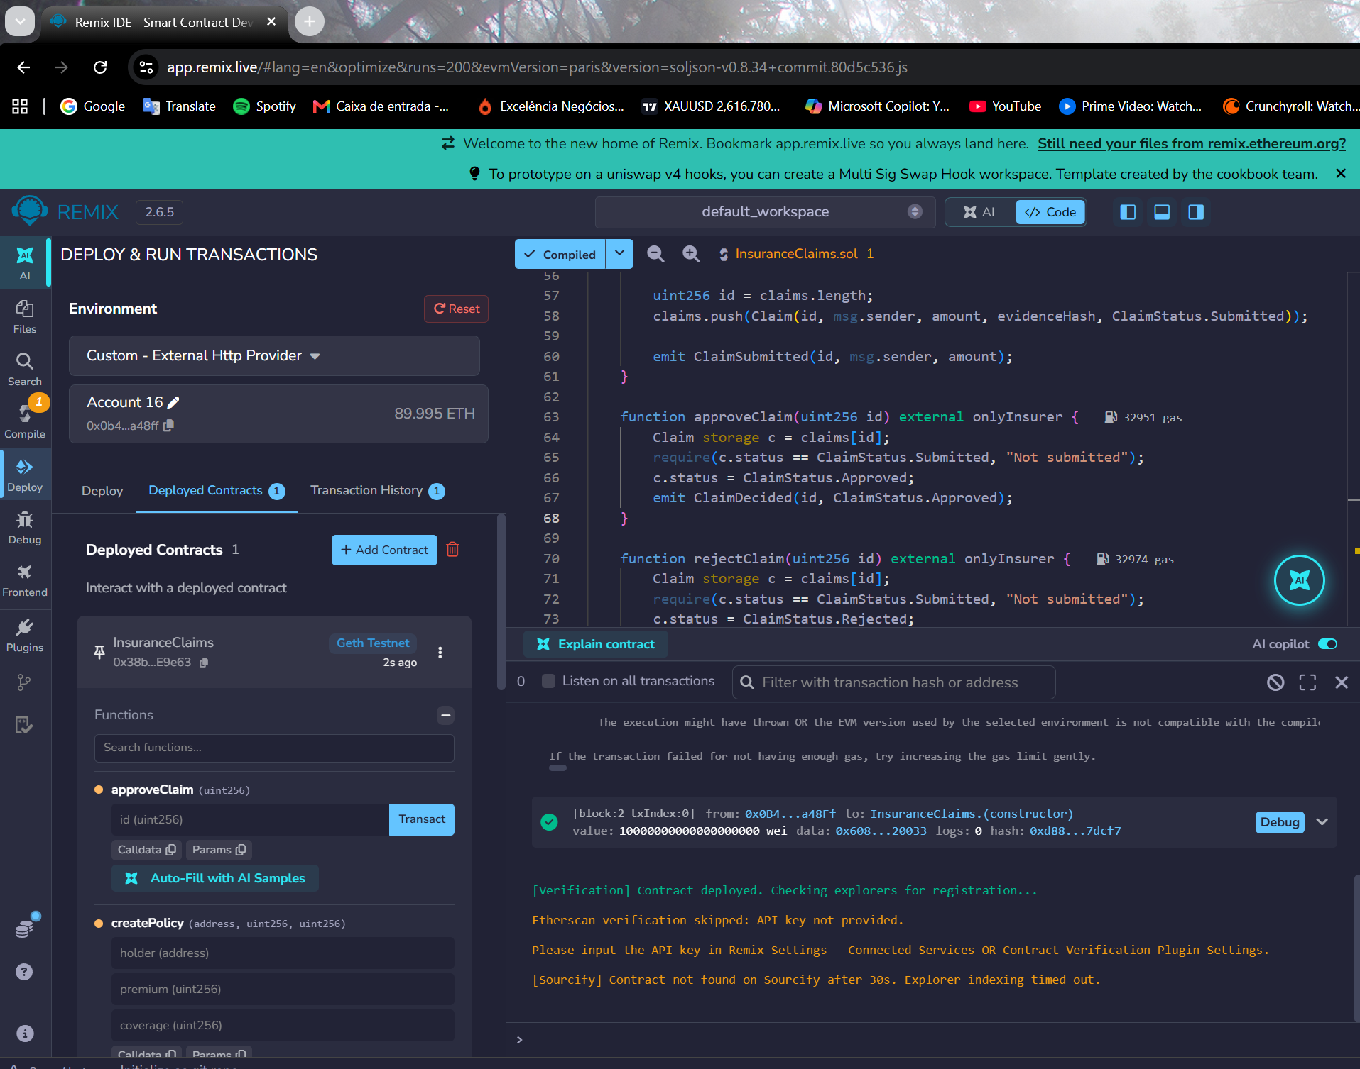
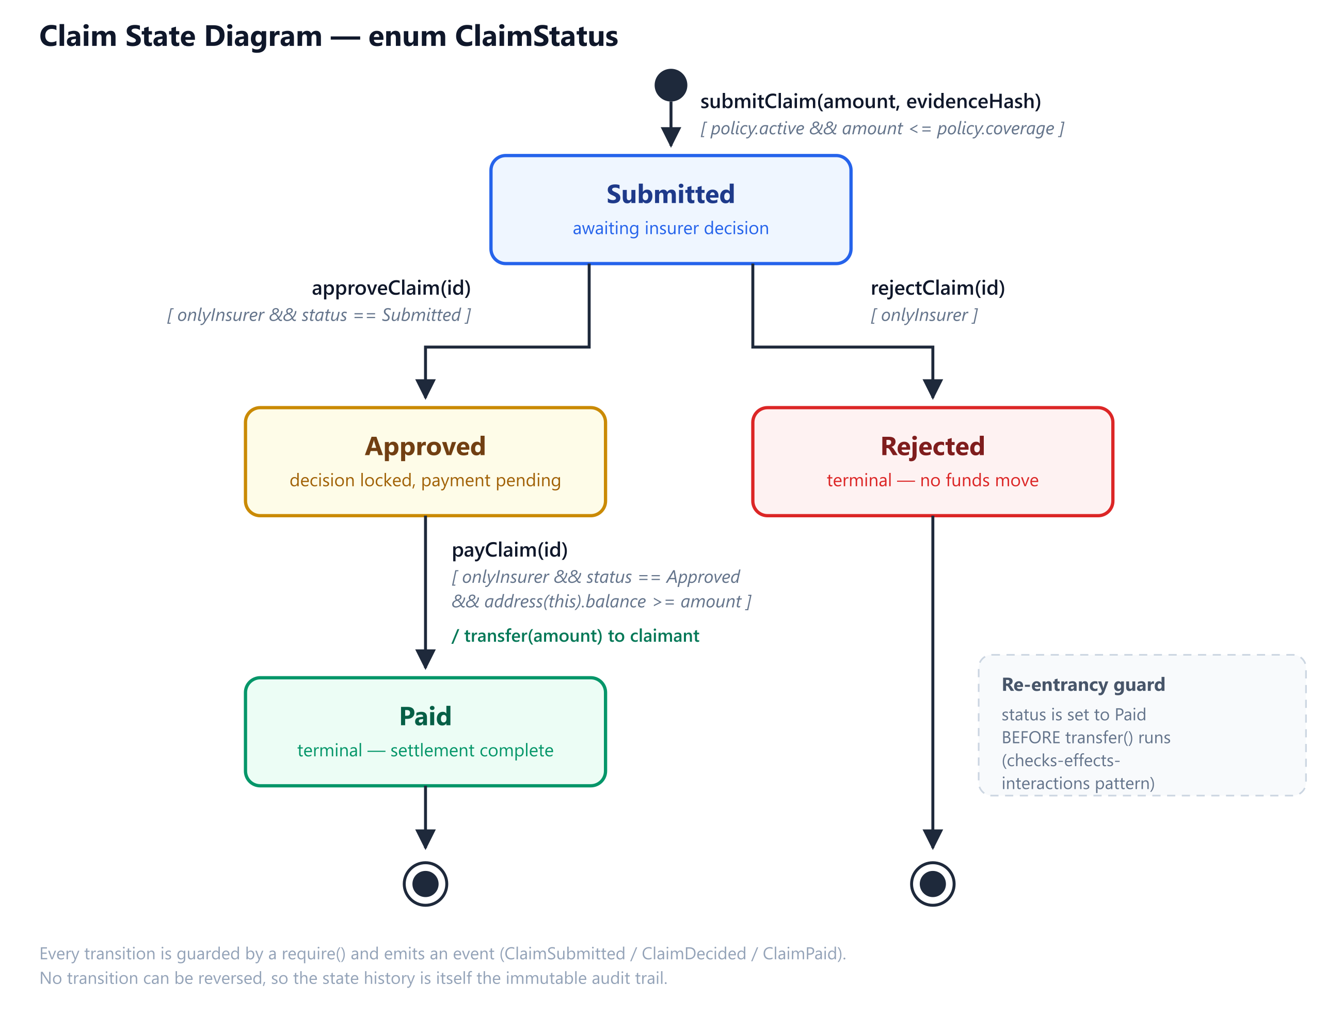
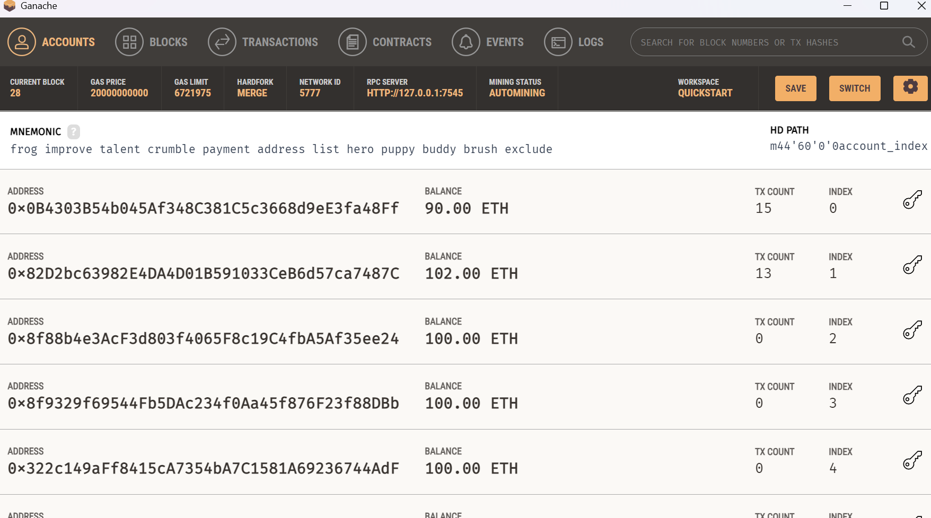
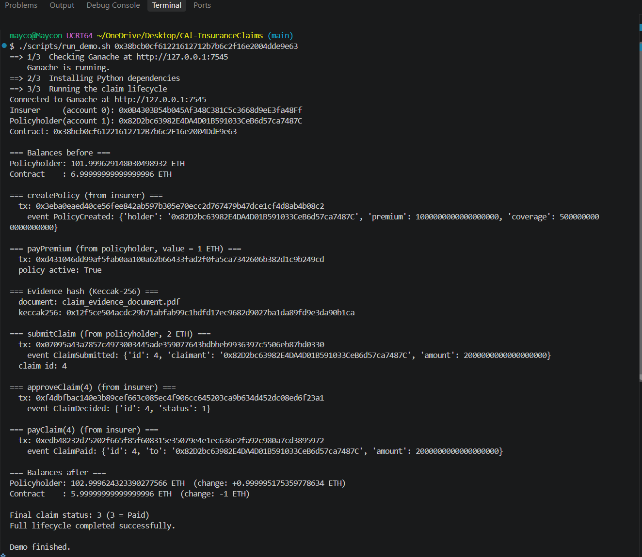
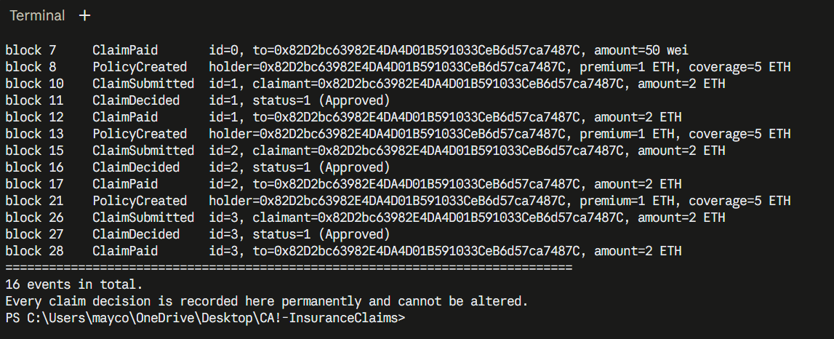
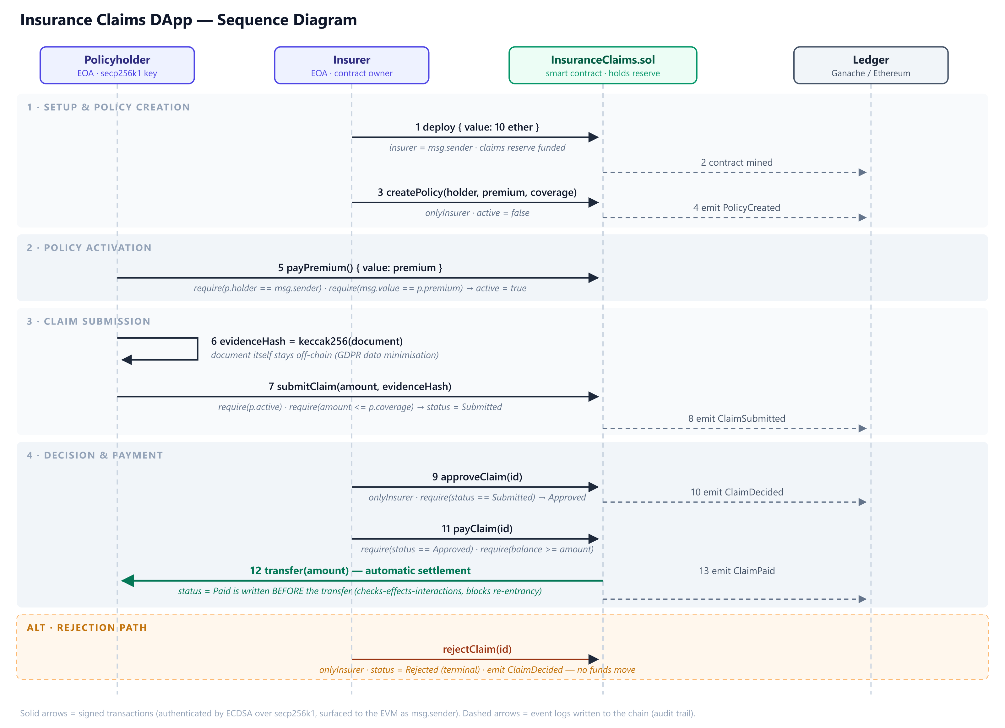
FINDINGS
Blockchain-Based Insurance Claims Processing
A decentralised application on Ethereum for policy, claim and settlement handling
Maycon Almeida (2024354) | CCT College Dublin | Blockchain & Distributed Ledger Technologies | Lecturer: Dr. Muhammad Iqbal | github.com/MikeAlme13/CA--InsuranceClaims
ABSTRACT
RESEARCH PARADIGM
Automated settlement
Insurance claims are often slow, costly, and confusing. Claims pass between brokers, loss adjusters, and administrators, with each group checking the same information in different databases. Policyholders usually cannot see how their claim is progressing. This project introduces a decentralised app on Ethereum, where a smart contract coordinates the process. The system records policies, claims, decisions, and payments on an immutable ledger. Supporting documents are stored off-chain and linked by Keccak-256 hashes. When a claim is approved, the contract automatically sends payment. The contract was tested on a local Ganache chain using Remix and a Python client.
Three new technologies build on this design. Decentralised oracle networks allow contracts to respond to off-chain events, so a parametric policy can settle automatically without human involvement (Caldarelli, 2020). Layer-2 rollups greatly reduce transaction costs, making low-premium insurance possible. The contract itself does not need changes because these rollups are EVM-equivalent (Thibault et al., 2022). Zero-knowledge proofs let someone prove their claim meets policy rules without revealing their private data (Goldwasser et al., 1989).
Compilation and deployment
We also ran the same lifecycle using a Python Web3 client instead of Remix, which shows that any application can use the contract. The payClaim function updates the Paid status before transferring funds, following the checks-effects-interactions pattern. This approach prevents the reentrancy issue that caused the 2016 DAO incident (Atzei et al., 2017).
I compiled the contract using solc 0.8.34 and deployed it with a 10 ETH reserve. My first attempt failed because solc 0.8.20 and newer versions target the Shanghai EVM and use PUSH0, which Ganache 7.7.3 does not support. The transaction used up all the gas and did not deploy the contract. Changing the compiler EVM version to Paris fixed the issue.
Claim lifecycle
The process ran from start to finish. A policy was set up with a 1 ETH premium for 5 ETH of coverage. Once the premium was paid, the policy became active. A claim for 2 ETH was submitted along with the Keccak-256 hash of the evidence. The claim was approved and paid out. As a result, the claimant’s balance increased by 2 ETH, while the reserve decreased by the same amount. Sixteen events were logged to create the audit trail.
RESEARCH QUESTIONS
The project is guided by four main questions:
1. Why does settlement take weeks when the decision itself is often straightforward?
2. Can a contract eliminate repeated verification by intermediaries and the related fees?
3. How can we prove evidence has not been changed without putting personal data on a public ledger?
4. What prevents either party from later denying what was submitted, approved, or paid?
RESEARCH METHODS
The design relies on two main building blocks. Each transaction is signed using ECDSA over secp256k1. Nodes then recover the signer's address, and the EVM shows this as msg.sender, which cannot be faked (Johnson et al., 2001). This approach secures access control without passwords and ensures non-repudiation. Documents themselves are not stored on-chain. Instead, it stores only the Keccak-256 digest, which proves the document has not changed and does not reveal personal data. This supports GDPR data minimisation (Finck, 2018).
CONCEPTUAL FRAMEWORK
This process has three main roles. The policyholder pays premiums and submits claims. The insurer decides whether to approve or reject claims and then makes payments. The contract maintains the policy register, claim ledger, and reserves, and enforces rules that administrators currently handle manually.
CONCLUSIONS
The prototype demonstrates that a contract can take on the coordinating roles of brokers and administrators. The claim record cannot be changed, decisions are verified by signature, and settlement happens automatically. However, there are clear limitations. The right to erasure does not fit well with a permanent ledger. Keeping documents off-chain helps, but does not fully solve the issue. The contract also relies on inputs it cannot check, and high mainnet gas fees make low-value cover impractical. Future work will address these three areas.
CONTRACT GUARDS
Access control under test
I tested each guard listed below on the deployed contract, and each one produced the revert shown.
We tested three failure cases on the deployed contract. When a policyholder tried to call approveClaim, the contract rejected it with Not insurer. Submitting a claim above the coverage limit returned Amount exceeds coverage. Using the wrong premium triggered Incorrect premium. Each failure reverted on-chain, and the contract recorded the reason.
Guard
onlyInsurer | policyholder | Not insurer
amount <= coverage | policyholder | Amount exceeds coverage
msg.value == premium | policyholder | Incorrect premium
policy.active | non-holder | Policy not active
status == Approved
REFERENCES
Atzei, N., Bartoletti, M. and Cimoli, T. (2017) 'A survey of attacks on Ethereum smart contracts (SoK)', Principles of Security and Trust. Springer, pp. 164-186.
Caldarelli, G. (2020) 'Understanding the blockchain oracle problem: a call for action', Information, 11(11), 509.
Finck, M. (2018) 'Blockchains and data protection in the European Union', European Data Protection Law Review, 4(1), pp. 17-35.
Goldwasser, S., Micali, S. and Rackoff, C. (1989) 'The knowledge complexity of interactive proof systems', SIAM Journal on Computing, 18(1), pp. 186-208.
Johnson, D., Menezes, A. and Vanstone, S. (2001) 'The elliptic curve digital signature algorithm (ECDSA)', International Journal of Information Security, 1, pp. 36-63.
Thibault, L.T., Sarry, T. and Hafid, A.S. (2022) 'Blockchain scaling using rollups: a comprehensive survey', IEEE Access, 10, pp. 93039-93054

